Slide 1
Getting Started with Computational Mathematics
Tutorial 1: Python, Basic Linear Predictions, and Kaggle Competitions
Presented by Greg DePaul (on behalf of SIAM)

Slide 2
Agenda
Installing Anaconda
Installing Dependencies
Registering with Kaggle
Creating a Notebook
Your FIRST submission!
The Future

Slide 3
Install Anaconda
https://www.anaconda.com/products/distribution

Slide 4
While we wait …
Head over to:
https://www.kaggle.com/competitions/
Create a new account
Select playground-series-s3e10
Join the competition
Download all of the files (train.csv, test.csv, sample_submission.csv)

Slide 5
Create a new environment in Anaconda
conda create --name SIAM
conda activate SIAM

Slide 6
Install a couple things …
conda install -c anaconda jupyter
conda install -c anaconda pandas
conda install -c anaconda scikit-learn

Slide 7
Time to Open Jupyter
In your console: jupyter notebook
Make a new notebook in the same directory as train.csv

Slide 8
Import Libraries
import pandas as pd
from collections import defaultdict
import numpy as np
from sklearn.model_selection import train_test_split
from sklearn import linear_model

Slide 9
Data Transformation
data_set = pd.read_csv("train.csv")
display(data_set.head())

Slide 10
Train / Test Split
y = data_set['Class']
X = data_set
X = X.drop("id",axis = 1)
X = X.drop("Class",axis = 1)
X_train,X_test,y_train,y_test = train_test_split(X,y,test_size=0.2)
Training Data 80%
Test 20%

Slide 11

Model Creation
regr = linear_model.LinearRegression()
regr.fit(X_train, y_train)
$$y= βX+ ε$$

Slide 12
Measure Performance Error
print("Mean squared error: %.2f" % np.mean((regr.predict(X_test) - y_test) ** 2))
print('Variance score: %.2f' % regr.score(X_test, y_test))

Slide 13
Submit Predictions
prediction_data_set = pd.read_csv("test.csv")
display(prediction_data_set.head())
test_ids = prediction_data_set.pop('id')
Z = prediction_data_set
predictions = regr.predict(Z)
df = pd.DataFrame(data={"id": test_ids, "Class": predictions})
df.to_csv("submission.csv", sep=',',index=False)

Slide 14
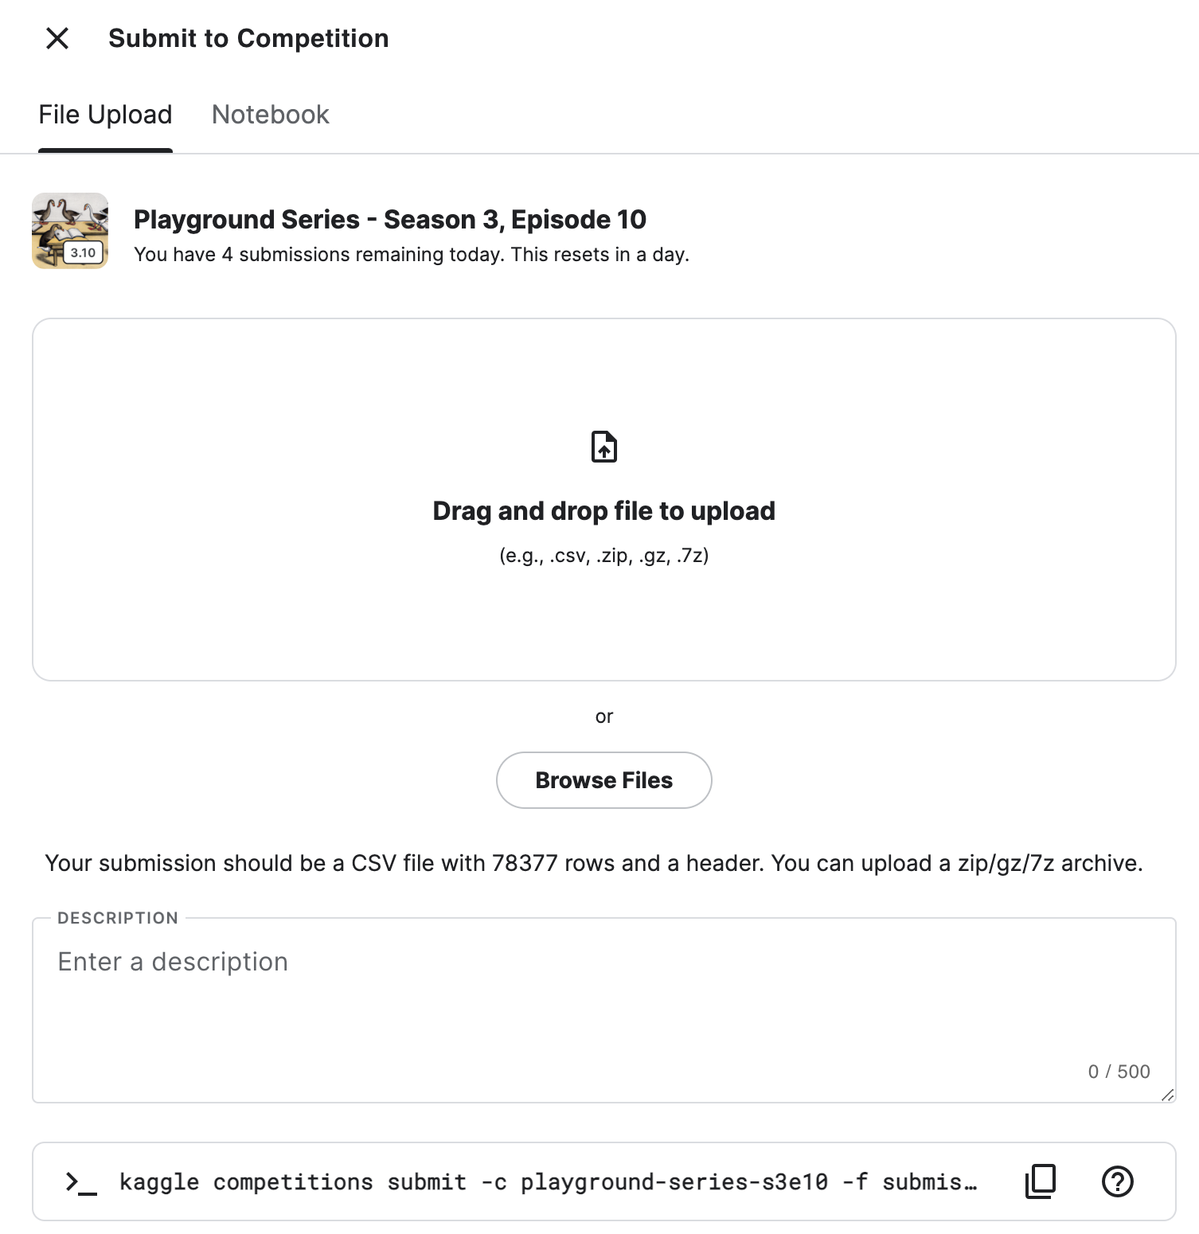
DRAG AND DROP SUBMISSIONS!

Slide 15
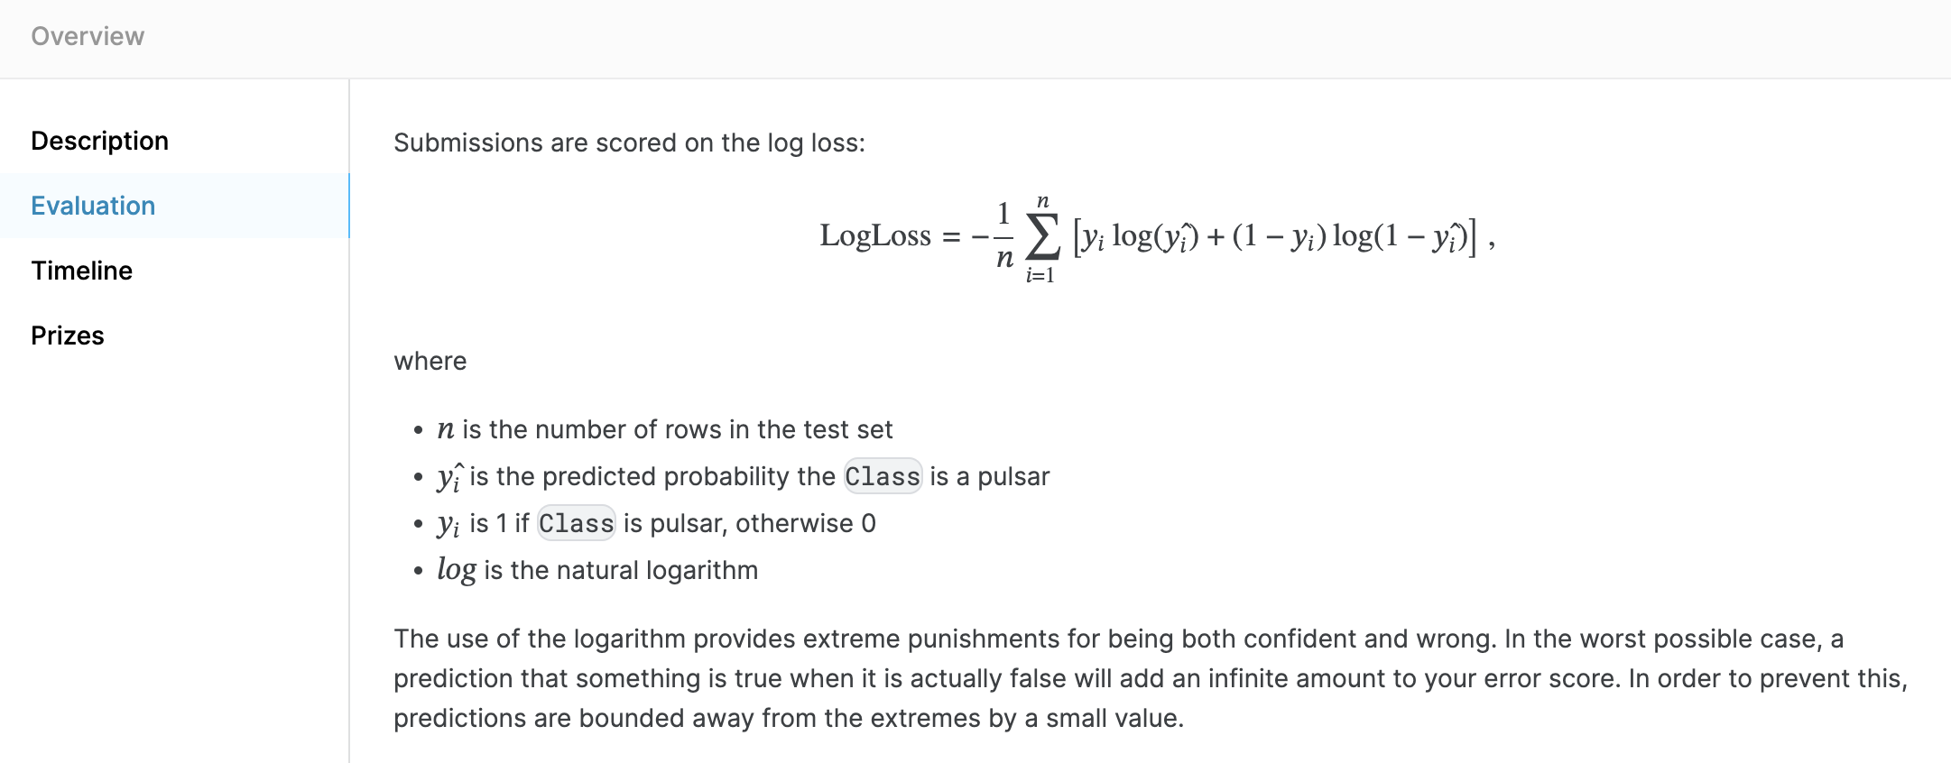
The Future
Aim for better evaluation

Slide 16
The Future
Aim for better predictions
Adopt a different model (glm, etc)

Slide 17
The Future
Aim for better predictions
Adopt a different model (glm, etc)
Go a different direction

Slide 18
For next week:
We are going to learn Algebraic Geometry (the actually useful stuff)
Need to install Sage:
conda create --name alggeo
conda activate alggeo
conda install -c conda-forge sage
(Takes a long time so do it before)
We’ll go over this math library.
Next quarter we’ll talk about R and Github.

